Slide 1
SQL SERVER
AMOL R PATIL PUNE

Slide 2
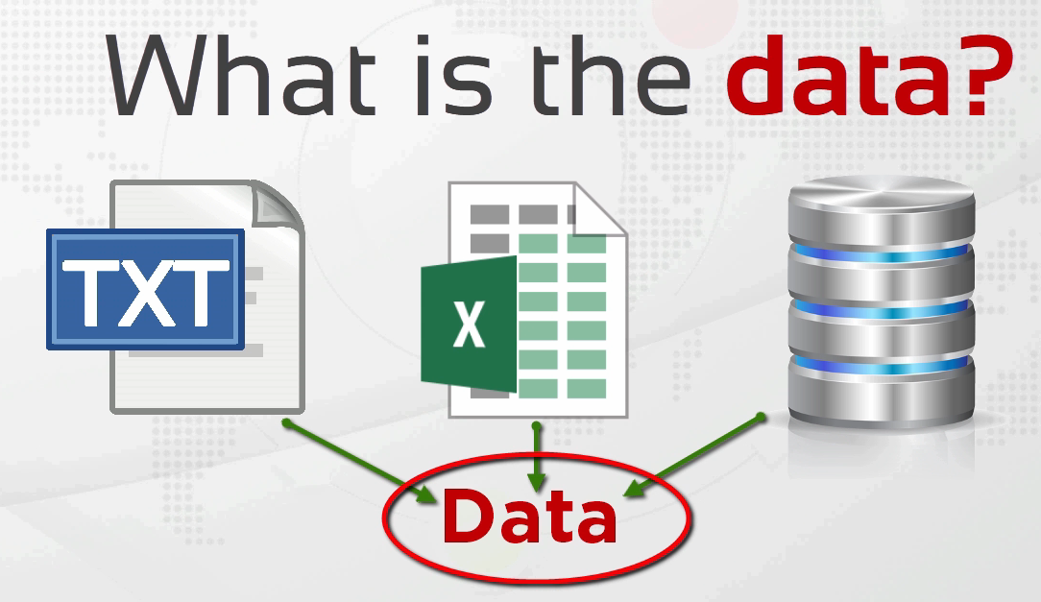
Data
Data is a collection of a distinct small unit of information. It can be used in a variety of forms like text, numbers, media, bytes, etc. it can be stored in pieces of paper or electronic memory, etc.

Slide 3
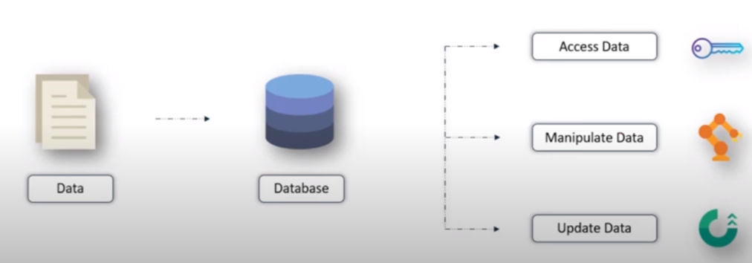
Database
In computing, a database is an organized collection of data (also known as a data store) stored and accessed electronically through the use of a database management system.

Slide 4
Databases are helpful because they allow you to:
Store Information: You can keep all your data in one place, making it easy to find and update.
Organize Data: You can sort and search for information quickly, just like you can easily find a document in a well-organized filing cabinet.
Retrieve Information: Databases help you retrieve and display the information you need, like finding a customer's details or checking product availability.
Keep Data Safe: You can set up security measures to protect your data from unauthorized access, just as you might lock your filing cabinet.
In essence, a database is like a digital, organized, and secure way to store and manage lots of information, making it easier for computers to work with and for people to access and use data efficiently.

Slide 5
Database Management System
Software system that enables users to define, create, maintain and control access to the database
DBMS provides the interface to perform the various operations like creation, deletion, modification, etc.
DBMS also facilitates oversight and control of databases, enabling a variety of administrative operations such as performance monitoring, tuning, and backup and recovery.

Slide 6
Codd proposed the following functions and services a fully-fledged general purpose DBMS should provide:
Data storage, retrieval and update
User accessible catalog or data dictionary describing the metadata
Support for transactions and concurrency
Facilities for recovering the database should it become damaged
Support for authorization of access and update of data
Access support from remote locations
Enforcing constraints to ensure data in the database abides by certain rules

Slide 7
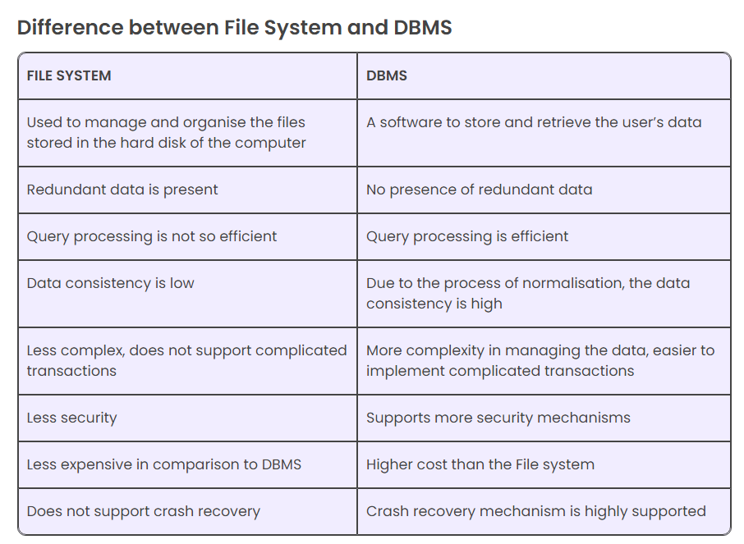

Slide 8
DBMS Advantages over File System
Data Redundancy and Inconsistency
Data Sharing:
Data Concurrency:
Data Searching
Data Integrity
Data Security
System Crashing
Backup
Interfaces
Maintenance

Slide 9
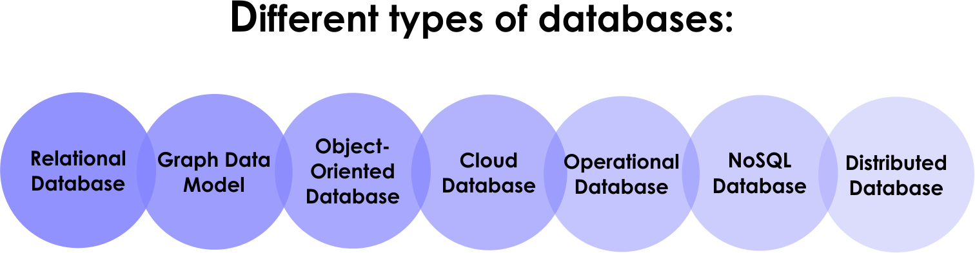

Slide 10
Relational Database Management System
A relational database is a (most commonly digital) database based on the relational model of data, as proposed by E. F. Codd in 1970
A system used to maintain relational databases is a relational database management system (RDBMS)
A relational model organizes data into one or more tables (or "relations") of columns and rows, with a unique key identifying each row. Rows are also called records or tuples. Columns are also called attributes.
Generally, each table/relation represents one "entity type" (such as customer or product). The rows represent instances of that type of entity (such as "Lee" or "chair") and the columns represent values attributed to that instance (such as address or price).

Slide 11
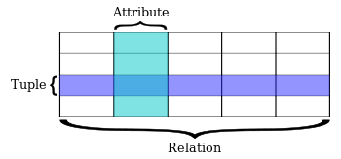
SQL term | Relational database term | Description
Row | Tuple or record | A data set representing a single item
Column | Attribute or field | A labeled element of a tuple, e.g. "Address" or "Date of birth"
Table | Relation or Base relvar | A set of tuples sharing the same attributes; a set of columns and rows
View or result set | Derived relvar | Any set of tuples; a data report from the RDBMS in response to a query

Slide 12
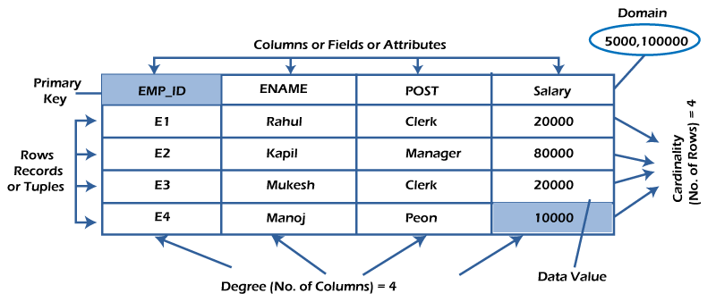
RDBMS Terminology

Slide 13
Row / Record
A row of a table is also called a record or tuple. It contains the specific information of each entry in the table. It is a horizontal entity in the table.
Properties of a row:
No two tuples are identical to each other in all their entries.
All tuples of the relation have the same format and the same number of entries.
The order of the tuple is irrelevant. They are identified by their content, not by their position.

Slide 14
Column / Attribute
A column is a vertical entity in the table which contains all information associated with a specific field in a table.
Every attribute of a relation must have a name.
Null values are permitted for the attributes.
Default values can be specified for an attribute automatically inserted if no other value is specified for an attribute.
Attributes that uniquely identify each tuple of a relation are the primary key.

Slide 15
Data Items / Cells
The smallest unit of data in the table is the individual data item. It is stored at the intersection of tuples and attributes
Data items are atomic.
The data items for an attribute should be drawn from the same domain.

Slide 16
RDBMS Terms
Degree: The total number of attributes that comprise a relation is known as the degree of the table.
Cardinality: The total number of tuples at any one time in a relation is known as the table's cardinality. The relation whose cardinality is 0 is called an empty table.
Domain: The domain refers to the possible values each attribute can contain. It can be specified using standard data types such as integers, floating numbers, etc. For example, An attribute entitled Marital_Status may be limited to married or unmarried values.
NULL Values : The NULL value of the table specifies that the field has been left blank during record creation. It is different from the value filled with zero or a field that contains space.

Slide 17
What is SQL Server ?
Microsoft SQL Server is a proprietary relational database management system developed by Microsoft.
As a database server, it is a software product with the primary function of storing and retrieving data as requested by other software applications—which may run either on the same computer or on another computer across a network (including the Internet).
Microsoft markets at least a dozen different editions of Microsoft SQL Server, aimed at different audiences and for workloads ranging from small single-machine applications to large Internet-facing applications with many concurrent users.

Slide 18
What is SQL ?
SQL stands for Structured Query Language and is a computer language that we use to interact with a relational database
In general terms, a query in SQL is a request to databases to fetch (or retrieve) the information. We use a common language - SQL, to query our databases.
Similar to other RDBMS software, SQL Server is built on top of SQL, a standard programming language for interacting with relational databases. SQL Server is tied to Transact-SQL, or T-SQL, the Microsoft’s implementation of SQL that adds a set of proprietary programming constructs.

Slide 19
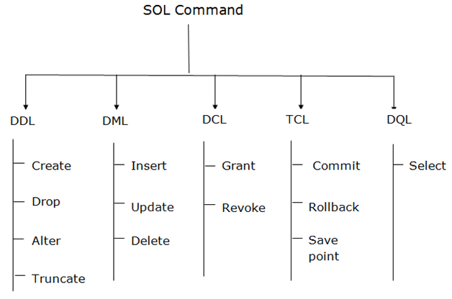

Slide 20
Data Definition - Database
Database is a collection of objects such as table, view, stored procedure, function, trigger, etc.
In MS SQL Server, two types of databases are available.
System databases
User Databases
Creating database - Create database <yourdatabasename>
Selecting database - Use <your database name>
Dropping database - Drop database <database name>
master.sys.databases contains list of user databases

Slide 21
Data Definition - Schema
A schema is a collection of database objects including tables, views, triggers, stored procedures, indexes, etc.
A database is the main container, it contains the data and log files, and all the schemas within it. You always back up a database, it is a discrete unit on its own.
Schemas are like folders within a database, and are mainly used to group logical objects together, which leads to ease of setting permissions by schema.
SQL Server provides us with some pre-defined schemas which have the same names as the built-in database users and roles, for example: dbo, guest, sys, and INFORMATION_SCHEMA.

Slide 22
Data Definition - Schema
The default schema for a newly created database is dbo, which is owned by the dbo user account.
By default, when you create a new user with the CREATE USER command, the user will take dbo as its default schema
If you want to list all schemas in the current database, you can query schemas from the sys.schemas

Slide 23
Data Definition - Table
CREATE TABLE [database_name.][schema_name.]table_name (
pk_column data_type PRIMARY KEY,
column_1 data_type NOT NULL,
column_2 data_type,
...,
table_constraints
);

Slide 24
Data Definition – Table Example
CREATE TABLE [database_name.][schema_name.]table_name (
pk_column data_type PRIMARY KEY,
column_1 data_type NOT NULL,
column_2 data_type,
...,
table_constraints
);

Slide 25
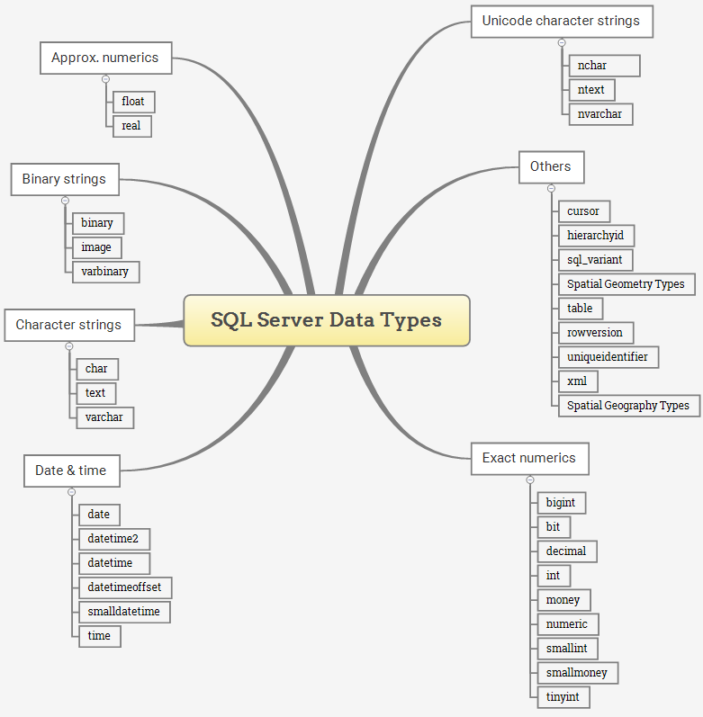

Slide 26
Identity Column
An identity column is a numeric column in a table that is automatically populated with an integer value each time a row is inserted
IDENTITY [ (seed , increment) ]
The seed is the value of the first row loaded into the table.
The increment is the incremental value added to the identity value of the previous row.
The default value of seed and increment is 1 i.e., (1,1). It means that the first row, which was loaded into the table, will have the value of one, the second row will have the value of 2 and so on

Slide 27
Data Definition - Sequence
In SQL Server, a sequence is a user-defined schema-bound object that generates a sequence of numbers according to a specified specification.
A sequence of numeric values can be in ascending or descending order at a defined interval and may cycle if requested.
CREATE SEQUENCE [schema_name.] sequence_name
[ AS integer_type ]
[ START WITH start_value ]
[ INCREMENT BY increment_value ]
[ { MINVALUE [ min_value ] } | { NO MINVALUE } ]
[ { MAXVALUE [ max_value ] } | { NO MAXVALUE } ]
[ CYCLE | { NO CYCLE } ]
[ { CACHE [ cache_size ] } | { NO CACHE } ];

Slide 28
Data Definition – Sequence - Example
create sequence roll_seq
as int
start with 10
increment by 10
select next value for roll_seq

Slide 29
Sequence Vs. Identity Column
Property/Feature | Identity | Sequence Object
Allow specifying minimum and/or maximum increment values | No | Yes
Allow resetting the increment value | No | Yes
Allow caching increment value generating | No | Yes
Allow specifying starting increment value | Yes | Yes
Allow specifying increment value | Yes | Yes
Allow using in multiple tables | No | Yes

Slide 30
Add Column
ALTER TABLE table_name
ADD
column_name_1 data_type_1 column_constraint_1,
column_name_2 data_type_2 column_constraint_2,
...,
column_name_n data_type_n column_constraint_n;

Slide 31
Modify Column
SQL Server allows you to perform the following changes to an existing column of a table:
Modify the data type
Change the size
Add a NOT NULL constraint
ALTER TABLE table_name
ALTER COLUMN column_name new_data_type(size);
The new data type must be compatible with the old one, otherwise, you will get a conversion error in case the column has data and it fails to convert.

Slide 32
Drop Column
ALTER TABLE table_name
DROP COLUMN column_name_1, column_name_2,...;

Slide 33
Computed Column
ALTER TABLE table_name
ADD column_name AS expression [PERSISTED];

Slide 34
Drop / Rename / Truncate Table
SQL Server does not have any statement that directly renames a table. However, it does provide you with a stored procedure named sp_rename that allows you to change the name of a table.
EXEC sp_rename 'old_table_name', 'new_table_name’
DROP TABLE [IF EXISTS] [database_name.][schema_name.]table_name;
TRUNCATE TABLE [database_name.][schema_name.]table_name;

Slide 35
Truncate Table Vs. Delete All
The TRUNCATE TABLE has the following advantages over the DELETE statement:
Use less transaction log
The DELETE statement removes rows one at a time and inserts an entry in the transaction log for each removed row. On the other hand, the TRUNCATE TABLE statement deletes the data by deallocating the data pages used to store the table data and inserts only the page deallocations in the transaction logs.
2) Use fewer locks
When the DELETE statement is executed using a row lock, each row in the table is locked for removal. The TRUNCATE TABLE locks the table and pages, not each row.
3) Identity reset
If the table to be truncated has an identity column, the counter for that column is reset to the seed value when data is deleted by the TRUNCATE TABLE statement but not the DELETE statement.

Slide 36
Temporary Tables
Temporary tables in SQL Server also known as temp tables are used by database developers and DBAs to store data temporarily and work on this data for faster performance
Temporary tables are stored in TempDB
create table #table_name
(
column_name varchar(20),
column_no int
)

Slide 37
Data Definition - Synonym
In SQL Server, a synonym is an alias or alternative name for a database object such as a table, view, stored procedure, user-defined function, and sequence.
CREATE SYNONYM [ schema_name_1. ] synonym_name FOR object;
sys.synonyms

Slide 38
Select Into
The SELECT INTO statement creates a new table and inserts rows from the query into it.
SELECT
select_list
INTO
destination
FROM
source
[WHERE condition]

Slide 39
SQL Constraints
SQL constraints are used to specify rules for the data in a table
Constraints can be column level or table level.
The following constraints are commonly used in SQL:
NOT NULL - Ensures that a column cannot have a NULL value
UNIQUE - Ensures that all values in a column are different
PRIMARY KEY - A combination of a NOT NULL and UNIQUE. Uniquely identifies each row in a table
FOREIGN KEY - Prevents actions that would destroy links between tables
CHECK - Ensures that the values in a column satisfies a specific condition
DEFAULT - Sets a default value for a column if no value is specified
CREATE INDEX - Used to create and retrieve data from the database very quickly

Slide 40
Primary Key
A primary key is a column or a group of columns that uniquely identifies each row in a table. You create a primary key for a table by using the PRIMARY KEY constraint.
Primary key Column Constraint
CREATE TABLE table_name (
pk_column data_type PRIMARY KEY,
...
);
Primary key Table Constraint
CREATE TABLE table_name (
pk_column_1 data_type,
pk_column_2 data type,
...
PRIMARY KEY (pk_column_1, pk_column_2)
);

Slide 41
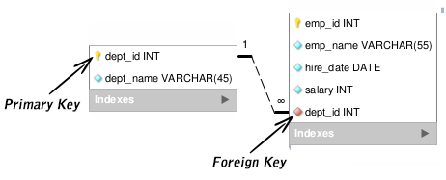
Foreign Key
A foreign key (FK) is a column or column combination that is used in two tables to establish and enforce a data relationship.
The FOREIGN KEY constraint is used to prevent actions that would destroy links between tables.
A FOREIGN KEY is a field (or collection of fields) in one table, that refers to the PRIMARY KEY in another table.
The table with the foreign key is called the child table, and the table with the primary key is called the referenced or parent table.

Slide 42
Foreign Key
Syntax
CONSTRAINT fk_constraint_name
FOREIGN KEY (column_1, column2,...)
REFERENCES parent_table_name(column1,column2,..)
The foreign key constraint ensures referential integrity. It means that you can only insert a row into the child table if there is a corresponding row in the parent table.

Slide 43
Foreign Key – Referential Actions
Syntax
FOREIGN KEY (foreign_key_columns)
REFERENCES parent_table(parent_key_columns)
ON UPDATE action
ON DELETE action;
The ON UPDATE and ON DELETE specify which action will execute when a row in the parent table is updated and deleted.
The following are permitted actions :
NO ACTION, CASCADE, SET NULL, and SET DEFAULT

Slide 44
Delete Action of rows in Parent Table
ON DELETE NO ACTION: SQL Server raises an error and rolls back the delete action on the row in the parent table.
ON DELETE CASCADE: SQL Server deletes the rows in the child table that is corresponding to the row deleted from the parent table.
ON DELETE SET NULL: SQL Server sets the rows in the child table to NULL if the corresponding rows in the parent table are deleted. To execute this action, the foreign key columns must be nullable.
ON DELETE SET DEFAULT SQL Server sets the rows in the child table to their default values if the corresponding rows in the parent table are deleted. To execute this action, the foreign key columns must have default definitions. Note that a nullable column has a default value of NULL if no default value specified.

Slide 45
Check Constraint
The CHECK constraint allows you to specify the values in a column that must satisfy a Boolean expression.
CREATE TABLE Persons ( ID int NOT NULL, LastName varchar(255) NOT NULL, FirstName varchar(255), Age int CHECK (Age>=18) );
For multiple columns
CONSTRAINT CHK_Person CHECK (Age>=18 AND City='Sandnes')

Slide 46
SQL Check on Alter Table
ALTER TABLE Persons ADD CHECK (Age>=18);
For multiple columns
CONSTRAINT CHK_Person CHECK (Age>=18 AND City='Sandnes’)
Drop Constraint
ALTER TABLE Persons DROP CONSTRAINT CHK_PersonAge;

Slide 47
Unique Constraint
The UNIQUE constraint is used to make sure that all the values in a column are unique.
You can use the UNIQUE constraint either on multiple columns or on a single column with. Apart from this, you can go forward and use the UNIQUE constraint to modify the existing tables.
While creating tables, a PRIMARY KEY constraint automatically has a UNIQUE constraint, to guarantee the uniqueness of a column.
A table can have many UNIQUE constraints but can have a single primary key constraint.

Slide 48
Unique Constraint for Group of Columns
CREATE TABLE table_name (
key_column data_type PRIMARY KEY,
column1 data_type,
column2 data_type,
...,
UNIQUE (column1,column2)
);
Add Unique Constraint to Existing Table
ALTER TABLE table_name
ADD CONSTRAINT constraint_name
UNIQUE(column1, column2,...);

Slide 49
Default Constraint
The DEFAULT constraint is used to set a default value for a column.
The default value will be added to all new records, if no other value is specified.
Default value in create Table : country varchar(255) default ‘INDIA’
Alter Table
Alter Table Persons Add Constraint df_country Default ‘INDIA’ for country
Drop Constraint
ALTER TABLE Persons ALTER COLUMN country DROP DEFAULT;

Slide 50
Create Index
Indexes are used to retrieve data from the database more quickly than otherwise. The users cannot see the indexes, they are just used to speed up searches/queries.
Note: Updating a table with indexes takes more time than updating a table without (because the indexes also need an update). So, only create indexes on columns that will be frequently searched against.
CREATE INDEX index_name ON table_name (column1, column2, ...);
DROP INDEX table_name.index_name;

Slide 51
SQL Server Exact Numeric Data Types
Data Type | Lower limit | Upper limit | Memory
bigint | −2^63 (−9,223,372, 036,854,775,808) | 2^63−1 (−9,223,372, 036,854,775,807) | 8 bytes
int | −2^31 (−2,147, 483,648) | 2^31−1 (−2,147, 483,647) | 4 bytes
smallint | −2^15 (−32,767) | 2^15 (−32,768) | 2 bytes
tinyint | 0 | 255 | 1 byte
bit | 0 | 1 | 1 byte/8bit column
decimal | −10^38+1 | 10^381−1 | 5 to 17 bytes
numeric | −10^38+1 | 10^381−1 | 5 to 17 bytes
money | −922,337, 203, 685,477.5808 | +922,337, 203, 685,477.5807 | 8 bytes
smallmoney | −214,478.3648 | +214,478.3647 | 4 bytes

Slide 52
SQL Server Character String Data Types
Data Type | Lower limit | Upper limit | Memory
char | 0 chars | 8000 chars | n bytes
varchar | 0 chars | 8000 chars | n bytes + 2 bytes
varchar (max) | 0 chars | 2^31 chars | n bytes + 2 bytes
text | 0 chars | 2,147,483,647 chars | n bytes + 4 bytes

Slide 53
SQL Server Binary and Unicode Character String Data Types
Data Type | Lower limit | Upper limit | Memory
nchar | 0 chars | 4000 chars | 2 times n bytes
nvarchar | 0 chars | 4000 chars | 2 times n bytes + 2 bytes
ntext | 0 chars | 1,073,741,823 char | 2 times the string length
Data Type | Lower limit | Upper limit | Memory
binary | 0 bytes | 8000 bytes | n bytes
varbinary | 0 bytes | 8000 bytes | The actual length of data entered + 2 bytes
image | 0 bytes | 2,147,483,647 bytes

Slide 54
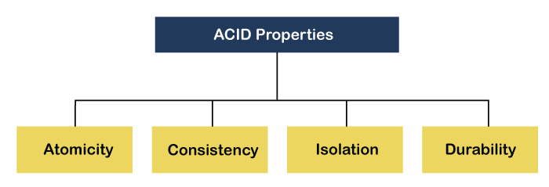
ACID Properties
Relational databases are also typically associated with transactional databases, which execute commands, or transactions, collectively. A popular example that is used to illustrate this is a bank transfer. A defined amount is withdrawn from one account, and then it is deposited within another. The total amount of money is withdrawn and deposited, and this transaction cannot occur in any kind of partial sense. Transactions have specific properties. Represented by the acronym, ACID,

Slide 55
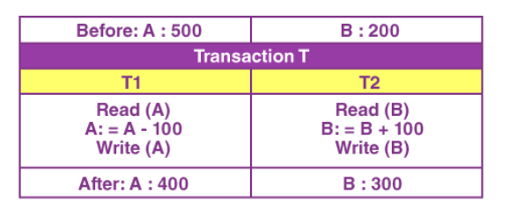
Atomicity
Atomicity guarantees that all of the commands that make up a transaction are treated as a single unit and either succeed or fail together.

Slide 56
Consistency
This means that integrity constraints must be maintained so that the database is consistent before and after the transaction. It refers to the correctness of a database
If we refer to the example discussed , then we have to maintain the total amount, both before and after the transaction.
Total after T occurs = 400 + 300 = 700.
Total before T occurs = 500 + 200 = 700.
Thus, the given database is consistent. Here, an inconsistency would occur when T1 completes, but then the T2 fails. As a result, the T would remain incomplete.

Slide 57
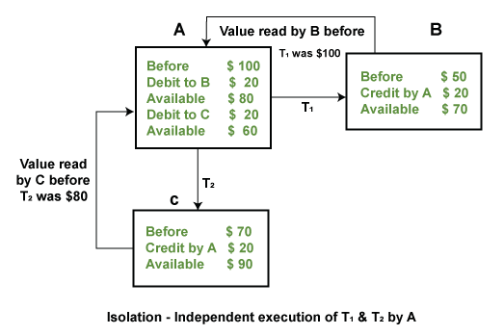
Isolation
Isolation ensures that all transactions run in an isolated environment. That enables running transactions concurrently because transactions don’t interfere with each other.

Slide 58
Durability
Durability guarantees that once the transaction completes and changes are written to the database, they are persisted. This ensures that data within the system will persist even in the case of system failures like crashes or power outages.

Slide 59
Normalization is the process of organizing the data in the database.
Normalization is used to minimize the redundancy from a relation or set of relations. It is also used to eliminate undesirable characteristics like Insertion, Update, and Deletion Anomalies.
Normalization divides the larger table into smaller and links them using relationships.
The normal form is used to reduce redundancy from the database table.
Normalization

Slide 60
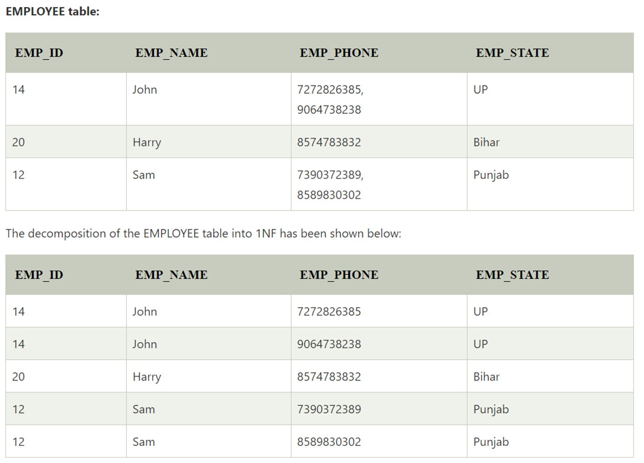
A relation will be 1NF if it contains an atomic value.
It states that an attribute of a table cannot hold multiple values. It must hold only single-valued attribute.
First normal form disallows the multi-valued attribute, composite attribute, and their combinations.
1NF

Slide 61
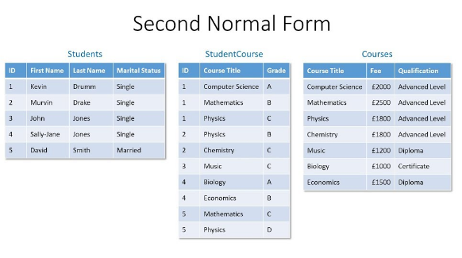
In the 2NF, relational must be in 1NF.
In the second normal form, all non-key attributes are fully functional dependent on the primary key
2NF

Slide 62
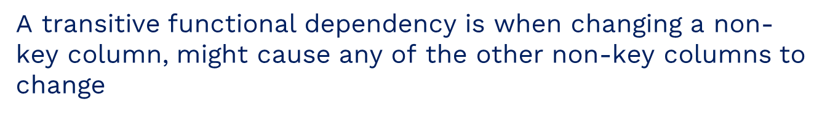
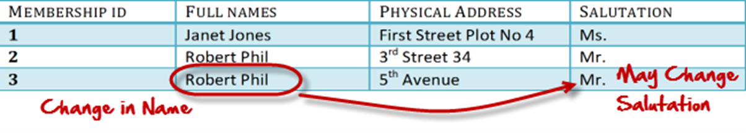
Rule 1- Be in 2NF
Rule 2- Has no transitive functional dependencies
3NF

Slide 63
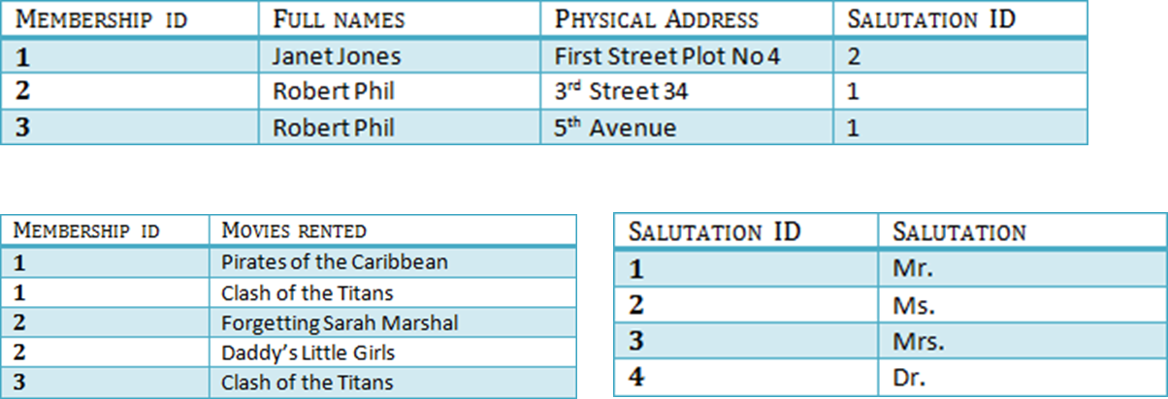
3NF

Slide 64
Boyce Codd normal form (BCNF)
BCNF is the advance version of 3NF. It is stricter than 3NF.
A table is in BCNF if every functional dependency X → Y, X is the super key of the table.
For BCNF, the table should be in 3NF, and for every FD, LHS is super key.
BCNF

Slide 65
EMP_ID | EMP_COUNTRY | EMP_DEPT | DEPT_TYPE | EMP_DEPT_NO
264 | India | Designing | D394 | 283
264 | India | Testing | D394 | 300
364 | UK | Stores | D283 | 232
364 | UK | Developing | D283 | 549
BCNF
In the above table Functional dependencies are as follows:
EMP_ID → EMP_COUNTRY
EMP_DEPT → {DEPT_TYPE, EMP_DEPT_NO}
Candidate key: {EMP-ID, EMP-DEPT}
The table is not in BCNF because neither EMP_DEPT nor EMP_ID alone are keys

Slide 66
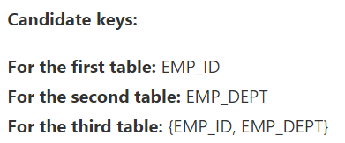
EMP_ID | EMP_COUNTRY
264 | India
264 | India
Functional dependencies:
EMP_ID → EMP_COUNTRY
EMP_DEPT → {DEPT_TYPE, EMP_DEPT_NO}
EMP_DEPT | DEPT_TYPE | EMP_DEPT_NO
Designing | D394 | 283
Testing | D394 | 300
Stores | D283 | 232
Developing | D283 | 549
BCNF
EMP_ID | EMP_DEPT
D394 | 283
D394 | 300
D283 | 232
D283 | 549

Slide 67
A relation will be in 4NF if it is in Boyce Codd normal form and has no multi-valued dependency.
For a dependency A → B, if for a single value of A, multiple values of B exists, then the relation will be a multi-valued dependency.
STU_ID | COURSE | HOBBY
21 | Computer | Dancing
21 | Math | Singing
34 | Chemistry | Dancing
74 | Biology | Cricket
59 | Physics | Hockey
4NF
The given STUDENT table is in 3NF, but the COURSE and HOBBY are two independent entity. Hence, there is no relationship between COURSE and HOBBY.
In the STUDENT relation, a student with STU_ID, 21 contains two courses, Computer and Math and two hobbies, Dancing and Singing. So there is a Multi-valued dependency on STU_ID, which leads to unnecessary repetition of data.
So to make the above table into 4NF, we can decompose it into two tables:

Slide 68
A relation is in 5NF if it is in 4NF and not contains any join dependency and joining should be lossless.
5NF is satisfied when all the tables are broken into as many tables as possible in order to avoid redundancy.
5NF is also known as Project-join normal form (PJ/NF).
5NF
SUBJECT | LECTURER | SEMESTER
Computer | Anshika | Semester 1
Computer | John | Semester 1
Math | John | Semester 1
Math | Akash | Semester 2
Chemistry | Praveen | Semester 1

Slide 69
SEMESTER | SUBJECT
Semester 1 | Computer
Semester 1 | Math
Semester 1 | Chemistry
Semester 2 | Math
SUBJECT | LECTURER
Computer | Anshika
Computer | John
Math | John
Math | Akash
Chemistry | Praveen
5NF
SEMSTER | LECTURER
Semester 1 | Anshika
Semester 1 | John
Semester 1 | John
Semester 2 | Akash
Semester 1 | Praveen

Slide 70

RDBMS Software's

Slide 71
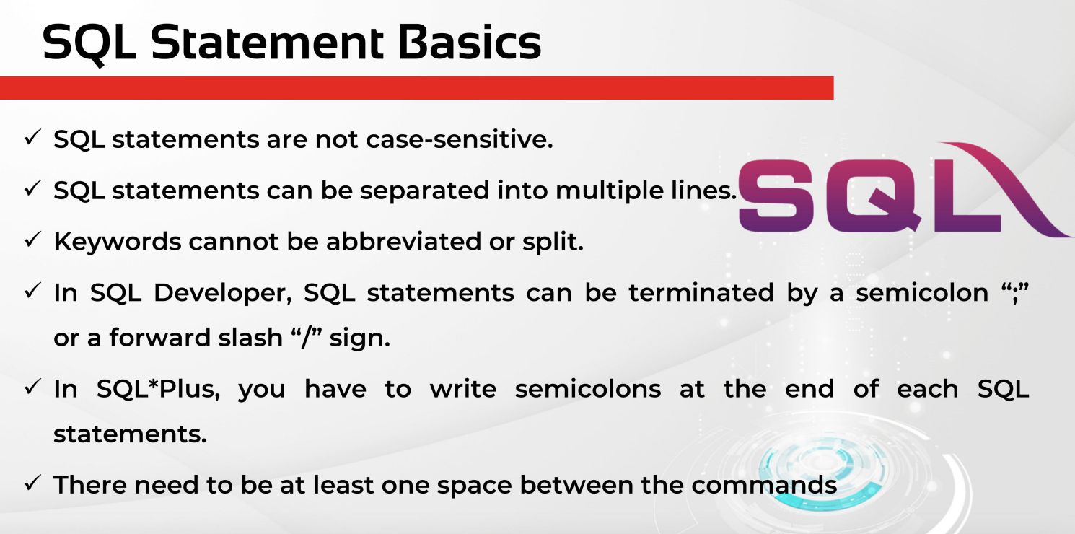

Slide 72
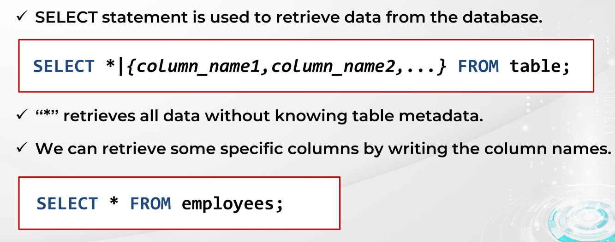
SELECT STATEMENT
SELECT
STATEMENT

Slide 73
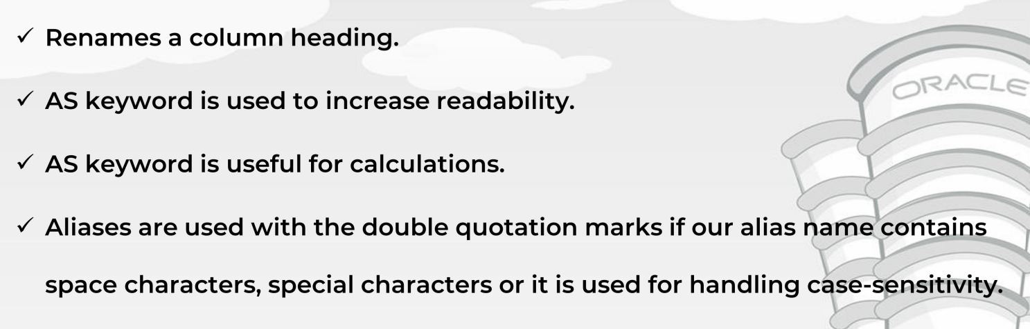
USING COLUMN ALIASING
SELECT
STATEMENT

Slide 74
ORDER BY CLAUSE
SELECT
select_list
FROM
table_name
ORDER BY
column_name | expression [ASC | DESC ];
SELECT
STATEMENT
ORDER BY clause is used to sort a result set by columns in ascending or descending order.

Slide 75
ORDER BY CLAUSE
Sort a result set by one column in ascending order
Sort a result set by one column in descending order
Sort a result set by multiple columns
Sort a result set by multiple columns and different orders
Sort a result set by a column that is not in the select list
Sort a result set by an expression
Sort by ordinal positions of columns
SELECT
STATEMENT

Slide 76
Offset Fetch
The OFFSET and FETCH clauses are the options of the ORDER BY clause. They allow you to limit the number of rows to be returned by a query.
SELECT
STATEMENT
ORDER BY column_list [ASC |DESC]
OFFSET offset_row_count {ROW | ROWS}
FETCH {FIRST | NEXT} fetch_row_count {ROW | ROWS} ONLY

Slide 77
Offset Fetch
The OFFSET clause specifies the number of rows to skip before starting to return rows from the query. The offset_row_count can be a constant, variable, or parameter that is greater or equal to zero.
The FETCH clause specifies the number of rows to return after the OFFSET clause has been processed. The offset_row_count can a constant, variable or scalar that is greater or equal to one.
The OFFSET clause is mandatory while the FETCH clause is optional. Also, the FIRST and NEXT are synonyms respectively so you can use them interchangeably. Similarly, you can use the FIRST and NEXT interchangeably.
SELECT
STATEMENT

Slide 78
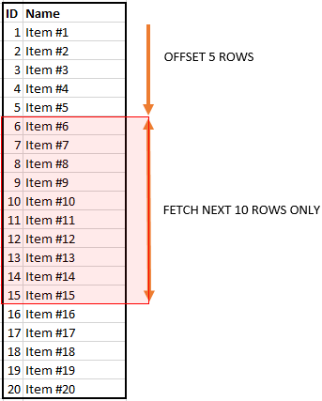
Offset Fetch
SELECT
STATEMENT

Slide 79
SELECT TOP
The SELECT TOP clause allows you to limit the number of rows or percentage of rows returned in a query result set.
SELECT TOP (expression) [PERCENT]
[WITH TIES]
FROM
table_name
ORDER BY
column_name;

Slide 80
SELECT DISTINCT
The SELECT TOP clause allows you to limit the number of rows or percentage of rows returned in a query result set.
SELECT DISTINCT
column_name1,
column_name2 ,
...
FROM
table_name;

Slide 81
WHERE CLAUSE
In the WHERE clause, you specify a search condition to filter rows returned by the FROM clause. The WHERE clause only returns the rows that cause the search condition to evaluate to TRUE.
SELECT
select_list
FROM
table_name
WHERE
search_condition;

Slide 82
WHERE CLAUSE
In the WHERE clause, you specify a search condition to filter rows returned by the FROM clause. The WHERE clause only returns the rows that cause the search condition to evaluate to TRUE.
SELECT
select_list
FROM
table_name
WHERE
search_condition;

Slide 83
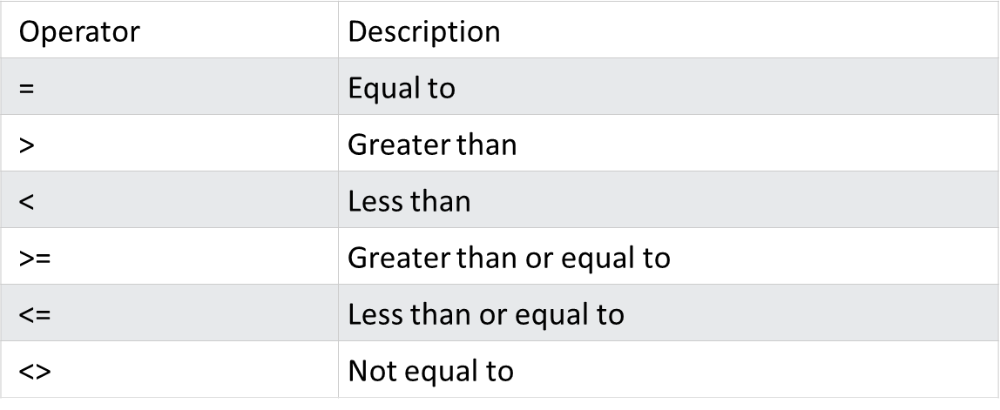
SQL SERVER RELATIOANL OPERATORS

Slide 84
SQL SERVER LOGICAL OPERATORS
Operator | Description
ALL | TRUE if all of the subquery values meet the condition | Try it
AND | TRUE if all the conditions separated by AND is TRUE | Try it
ANY | TRUE if any of the subquery values meet the condition | Try it
BETWEEN | TRUE if the operand is within the range of comparisons | Try it
EXISTS | TRUE if the subquery returns one or more records | Try it
IN | TRUE if the operand is equal to one of a list of expressions | Try it
LIKE | TRUE if the operand matches a pattern | Try it
NOT | Displays a record if the condition(s) is NOT TRUE | Try it
OR | TRUE if any of the conditions separated by OR is TRUE | Try it
SOME | TRUE if any of the subquery values meet the condition

Slide 85
SQL SERVER LIKE OPERATOR
Symbol | Description | Example
% | Represents zero or more characters | bl% finds bl, black, blue, and blob
_ | Represents a single character | h_t finds hot, hat, and hit
[] | Represents any single character within the brackets | h[oa]t finds hot and hat, but not hit
^ | Represents any character not in the brackets | h[^oa]t finds hit, but not hot and hat
- | Represents any single character within the specified range | c[a-b]t finds cat and cbt

Slide 86
SQL SERVER LIKE OPERATOR
LIKE Operator | Description
WHERE CustomerName LIKE 'a%' | Finds any values that start with "a"
WHERE CustomerName LIKE '%a' | Finds any values that end with "a"
WHERE CustomerName LIKE '%or%' | Finds any values that have "or" in any position
WHERE CustomerName LIKE '_r%' | Finds any values that have "r" in the second position
WHERE CustomerName LIKE 'a_%' | Finds any values that start with "a" and are at least 2 characters in length
WHERE CustomerName LIKE 'a__%' | Finds any values that start with "a" and are at least 3 characters in length
WHERE ContactName LIKE 'a%o' | Finds any values that start with "a" and ends with "o"

Slide 87
SQL SERVER NULL
In the database world, NULL is used to indicate the absence of any data value.
The NULL does not equal anything, even itself. It means that NULL is not equal to NULL because each NULL could be different.
The results of the following comparisons are UNKNOWN:
NULL = 0
NULL <> 0
NULL > 0
NULL = NULL
To test whether a value is NULL or not, you always use the IS NULL operator.

Slide 88
SQL SERVER JOINS
A JOIN clause is used to combine rows from two or more tables, based on a related column between them.
(INNER) JOIN: Returns records that have matching values in both tables
LEFT (OUTER) JOIN: Returns all records from the left table, and the matched records from the right table
RIGHT (OUTER) JOIN: Returns all records from the right table, and the matched records from the left table
FULL (OUTER) JOIN: Returns all records when there is a match in either left or right table

Slide 89
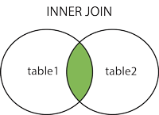
INNER JOIN
SELECT
select_list
FROM
T1
INNER JOIN T2 ON join_predicate;
The INNER JOIN clause compares each row of table T1 with rows of table T2 to find all pairs of rows that satisfy the join predicate. If the join predicate evaluates to TRUE, the column values of the matching rows of T1 and T2 are combined into a new row and included in the result set.

Slide 90
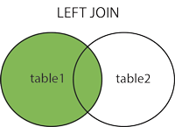
LEFT JOIN
SELECT
select_list
FROM
T1
LEFT JOIN T2 ON join_predicate;
The LEFT JOIN returns all rows from the left table and the matching rows from the right table. If no matching rows are found in the right table, NULL are used.

Slide 91
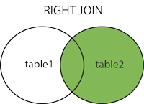
LEFT JOIN
SELECT
select_list
FROM
T1
RIGHT JOIN T2 ON join_predicate;
The RIGHT JOIN returns all rows from the right table and the matching rows from the left table. If no matching rows are found in the left table, NULL are used.

Slide 92
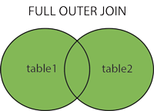
FULL JOIN
SELECT
select_list
FROM
T1
FULL JOIN T2 ON join_predicate;
The FULL OUTER JOIN keyword returns all records when there is a match in left (table1) or right (table2) table records.

Slide 93
SQL SERVER STRING FUNCTIONS
Function | Description
ASCII | Returns the ASCII value for the specific character
CHAR | Returns the character based on the ASCII code
CHARINDEX | Returns the position of a substring in a string
CONCAT | Adds two or more strings together
Concat with + | Adds two or more strings together
CONCAT_WS | Adds two or more strings together with a separator
DATALENGTH | Returns the number of bytes used to represent an expression
DIFFERENCE | Compares two SOUNDEX values, and returns an integer value
FORMAT | Formats a value with the specified format
LEFT | Extracts a number of characters from a string (starting from left)
LEN | Returns the length of a string
LOWER | Converts a string to lower-case
LTRIM | Removes leading spaces from a string

Slide 94
SQL SERVER STRING FUNCTIONS
Function | Description
PATINDEX | Returns the position of a pattern in a string
REPLACE | Replaces all occurrences of a substring within a string, with a new substring
REPLICATE | Repeats a string a specified number of times
REVERSE | Reverses a string and returns the result
RIGHT | Extracts a number of characters from a string (starting from right)
RTRIM | Removes trailing spaces from a string
SOUNDEX | Returns a four-character code to evaluate the similarity of two strings
SPACE | Returns a string of the specified number of space characters
STR | Returns a number as string
STUFF | Deletes a part of a string and then inserts another part into the string, starting at a specified position
SUBSTRING | Extracts some characters from a string
TRIM | Removes leading and trailing spaces (or other specified characters) from a string
UNICODE | Returns the Unicode value for the first character of the input expression
UPPER | Converts a string to upper-case

Slide 95
SQL SERVER DATE FUNCTIONS
Function | Description
CURRENT_TIMESTAMP | Returns the current date and time
DATEADD | Adds a time/date interval to a date and then returns the date
DATEDIFF | Returns the difference between two dates
DATEFROMPARTS | Returns a date from the specified parts (year, month, and day values)
DATENAME | Returns a specified part of a date (as string)
DATEPART | Returns a specified part of a date (as integer)
DAY | Returns the day of the month for a specified date
GETDATE | Returns the current database system date and time
GETUTCDATE | Returns the current database system UTC date and time
ISDATE | Checks an expression and returns 1 if it is a valid date, otherwise 0
MONTH | Returns the month part for a specified date (a number from 1 to 12)
SYSDATETIME | Returns the date and time of the SQL Server
YEAR | Returns the year part for a specified date

Slide 96
GROUP BY CLAUSE
SELECT
select_list
FROM
table_name
GROUP BY
column_name1,
column_name2 ,...;
The GROUP BY clause allows you to arrange the rows of a query in groups. The groups are determined by the columns that you specify in the GROUP BY clause.
In practice, the GROUP BY clause is often used with aggregate functions for generating summary reports.

Slide 97
HAVING CLAUSE
SELECT
select_list
FROM
table_name
GROUP BY
group_list
HAVING
conditions;
The HAVING clause is often used with the GROUP BY clause to filter groups based on a specified list of condition

Slide 98
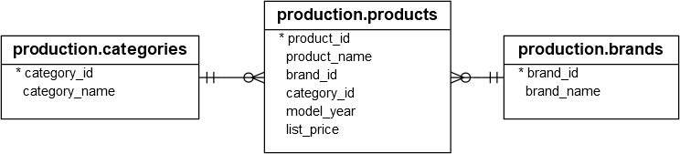
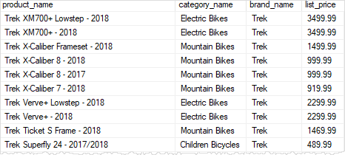
ASSIGNMENT - 2

Slide 99
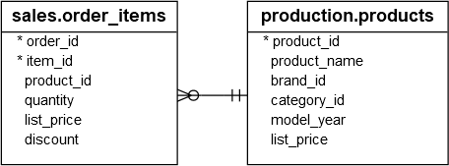
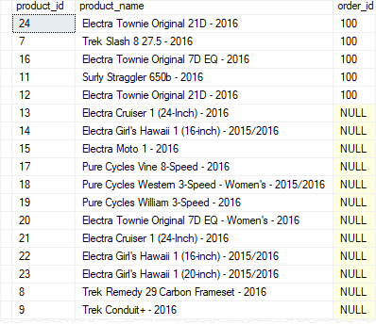
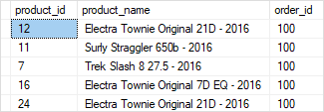
ASSIGNMENT - 2

Slide 100
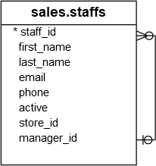
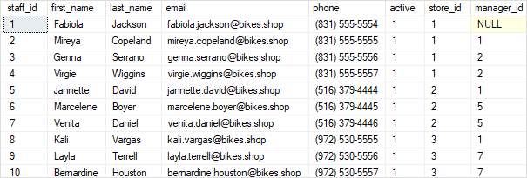
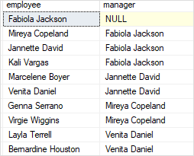
ASSIGNMENT - 2

Slide 101

ASSIGNMENT - 3
Find the number of orders placed by the customer by year:

Slide 102
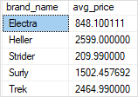
ASSIGNMENT - 3
Find the average list price by brand for all products with the model year 2018:

Slide 103
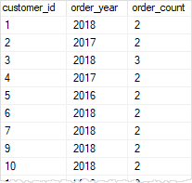
ASSIGNMENT - 3
Find the customers who placed at least two orders per year:

Slide 104

ASSIGNMENT - 3
finds product categories whose average list prices are between 500 and 1,000:

Slide 105

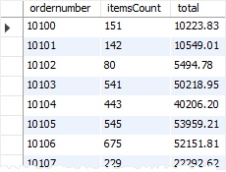
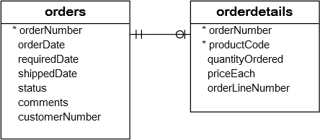
ASSIGNMENT - 3

Slide 106
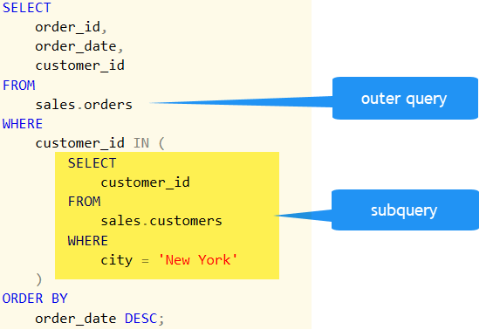
SQL Server SubQuery
A Subquery or Inner query or a Nested query is a query within another SQL query and embedded within clauses, most commonly in the WHERE clause. It is used to return data from a table, and this data will be used in the main query as a condition to further restrict the data to be retrieved.

Slide 107
SQL Server SubQuery
You can use a subquery in many places:
In place of an expression
With IN or NOT IN
With ANY or ALL
With EXISTS or NOT EXISTS
In UPDATE, DELETE, or INSERT statement
In the FROM clause

